Slide 1
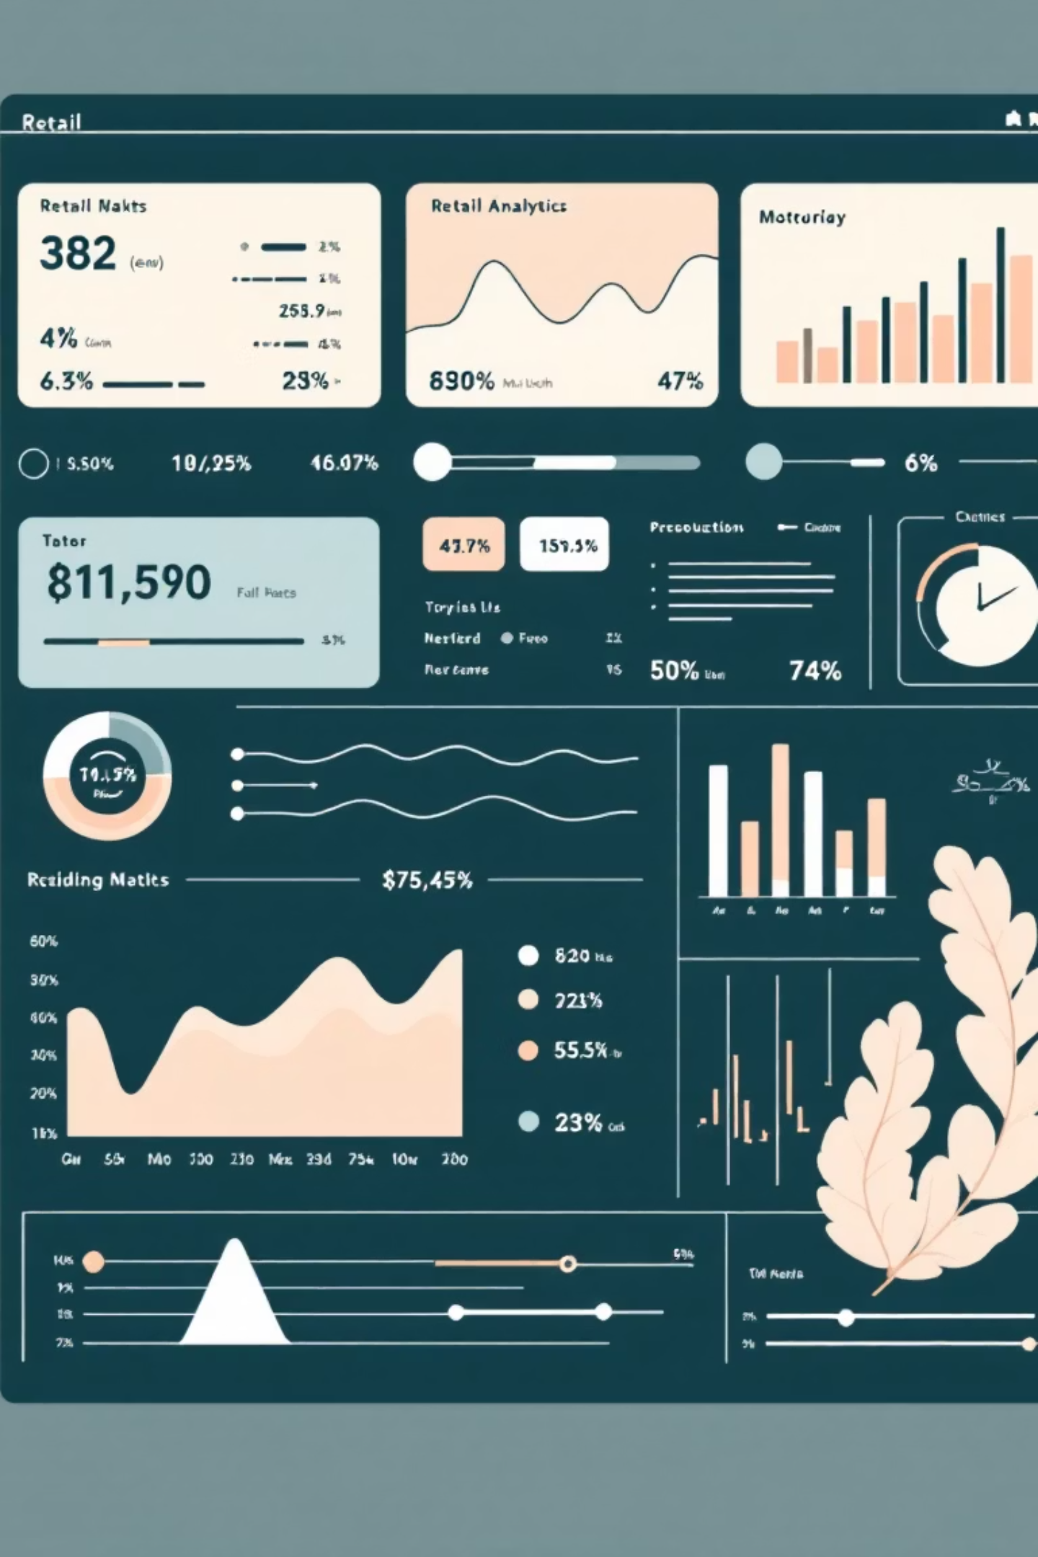
Customer Shopping Behavior Analysis
Understanding revenue drivers, customer loyalty, and product performance through data-driven insights

Slide 2

Key Highlights
High-Value Segments
Discount Effectiveness
Identified customer segments based on purchase history
Evaluated impact on spending behavior
Product Performance
Subscription Patterns
Analyzed category and product dominance
Assessed repeat buyer subscription likelihood

Slide 3
Business Questions
Which customer segments generate the most revenue?
Do discounts attract high-value customers or increase volume?
Which products dominate sales within each category?
Are repeat buyers more likely to subscribe?
Which age groups contribute most to revenue?

Slide 4
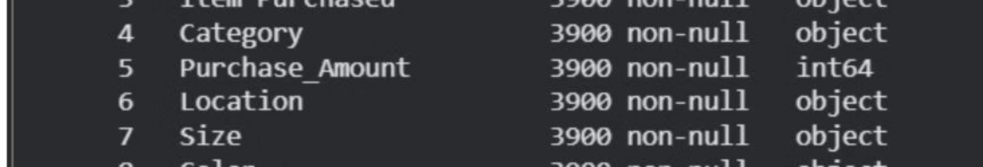
Dataset Overview
Source & Scale
Data Quality
Retail transactional dataset with ~3,900 transactions
Missing values in review ratings
Key Attributes
Redundant discount indicators identified
Demographics: Age, Gender, Location
Inconsistent categorical labels in purchase frequency
Purchase Data: Item, Category, Amount
Behavioral: Previous Purchases, Frequency, Discounts
Feedback: Review Rating
Logistics: Shipping Type, Season

Slide 5




Data Preparation Process
Data Cleaning
Standardized column names, handled missing values with median imputation
Feature Engineering
Created age groups using quantile-based binning, transformed purchase frequency
Customer Classification
Segmented customers based on purchase history patterns

Slide 6
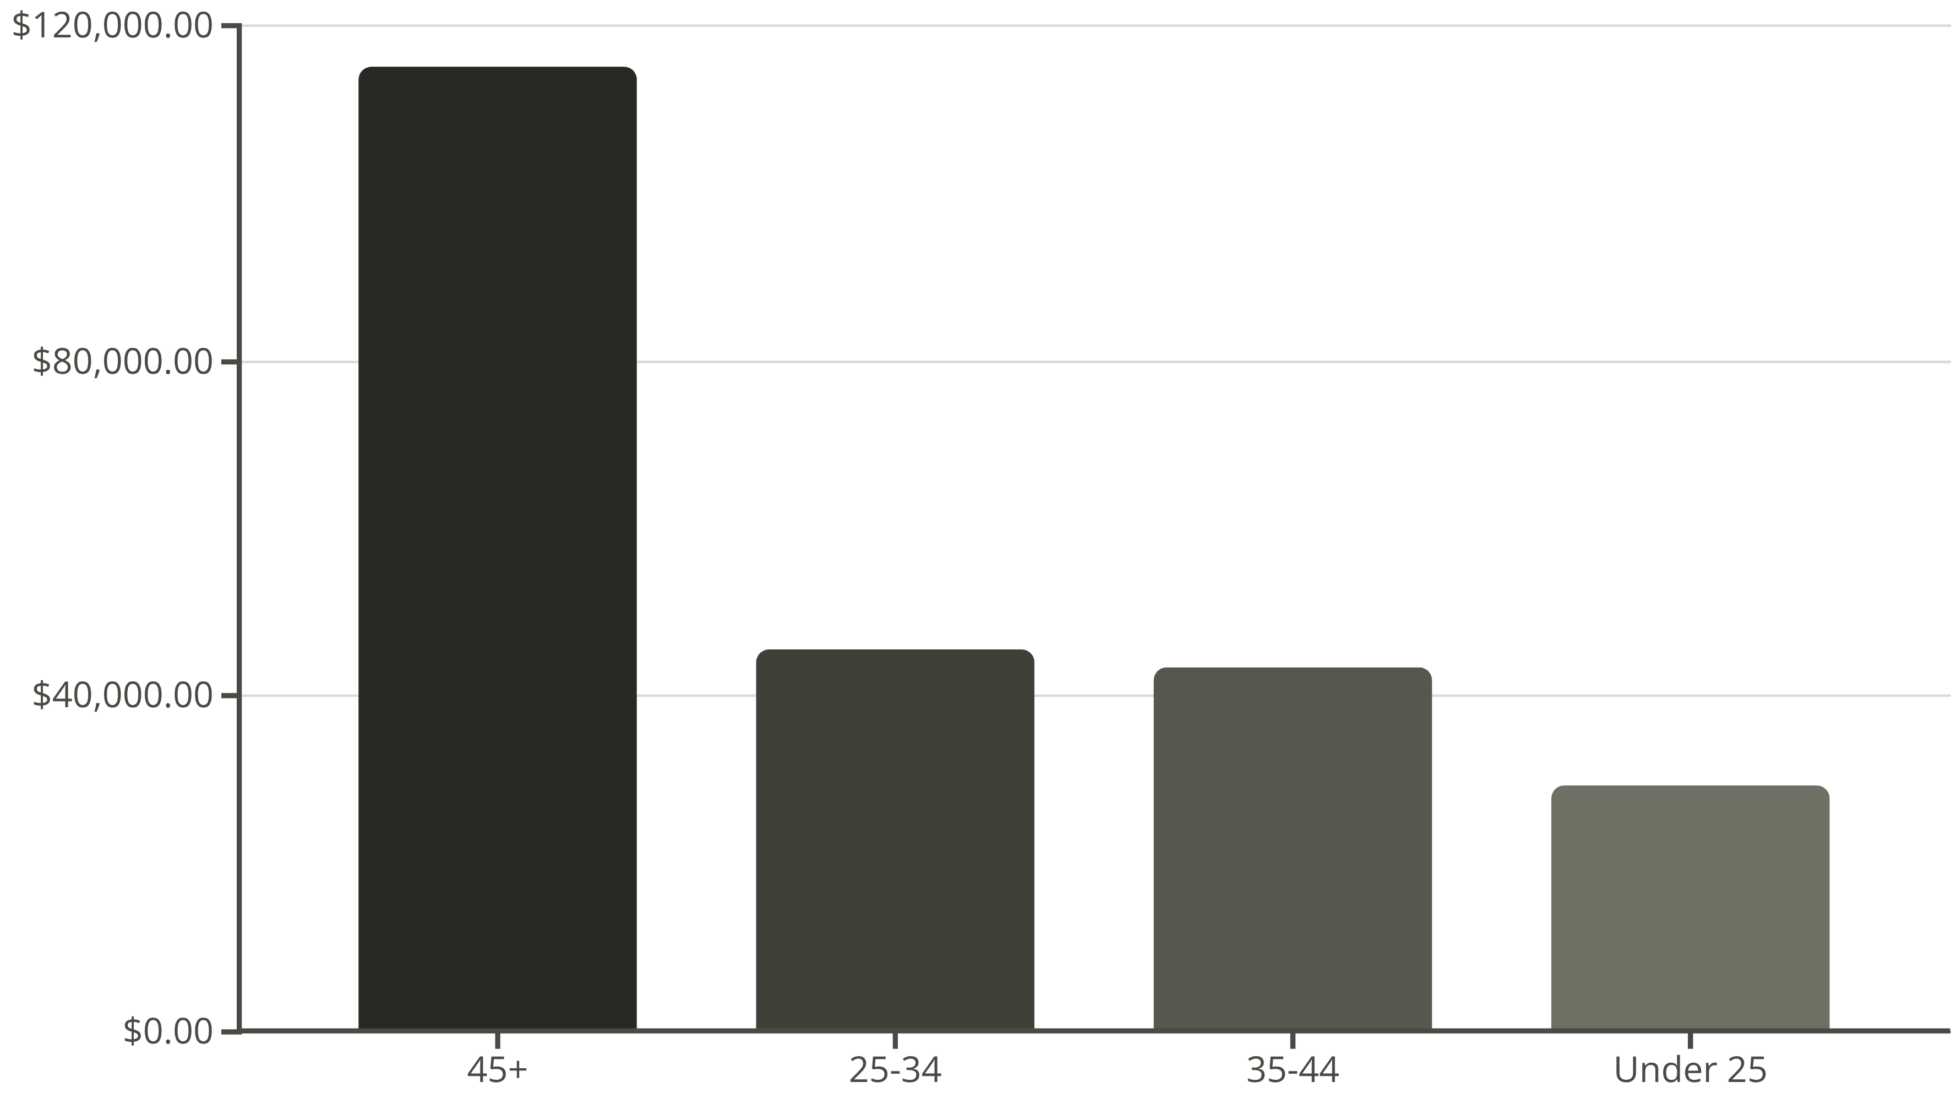
Revenue Distribution
45+ age group dominates revenue contribution, representing nearly 50% of total revenue

Slide 7

Top Products by Category
Accessories
Clothing
Jewelry leads with 171 purchases, followed by Belt and Sunglasses at 161 each
Pants & Blouse tied at 171 purchases, Shirt close behind at 169
Footwear
Outerwear
Sandals dominate with 160 purchases, Shoes at 150, Sneakers at 145
Jacket leads with 163 purchases, Coat follows at 161

Slide 8
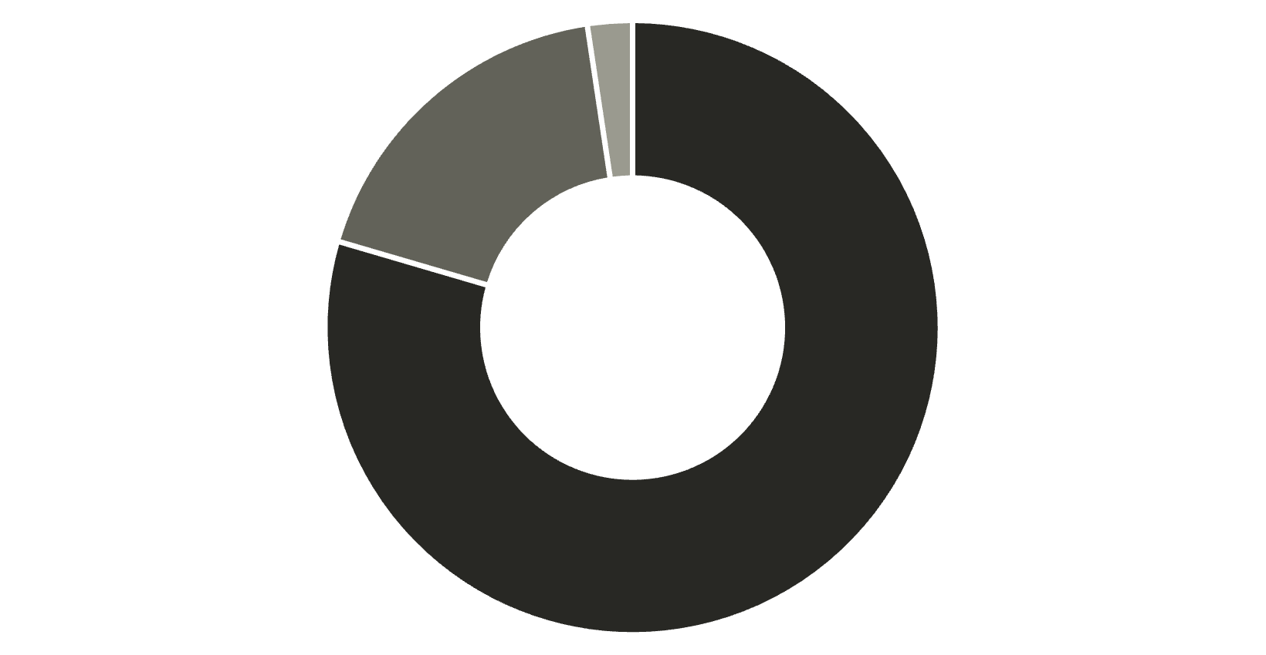
Customer Segmentation Insights
Strong Retention Potential
Loyal customers represent 80% of the customer base
Repeat buyers demonstrate higher subscription likelihood
Express shipping users show slightly higher average spending
Loyal
Returning
New

Slide 9
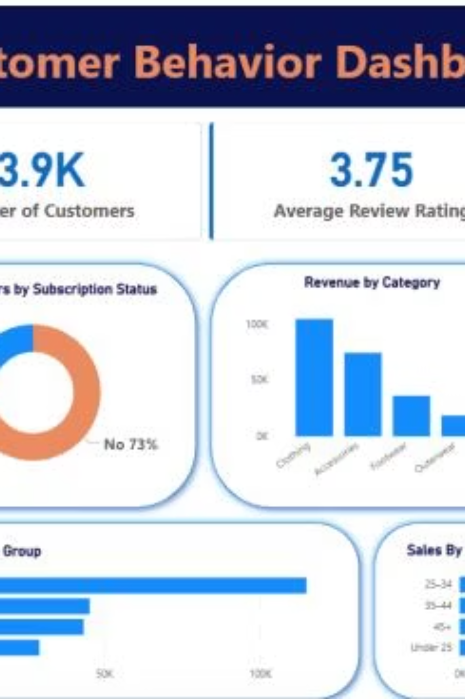
Dashboard Overview
3.9K
3.75
$59.76
Total Customers
Avg Review Rating
Avg Purchase Amount
27%
Subscription Rate

Slide 10


Strategic Recommendations
Loyalty Programs
Convert repeat buyers into subscribers through targeted incentives
Discount Strategy
Review products with high discount dependency to protect margins
Marketing Focus
Target 45+ age group with tailored campaigns for maximum revenue impact
Shipping Optimization
Link shipping incentives to higher spending behaviors

